Slide 1
Reinforcement Learning
Daniele Marazzina
Politecnico di Milano
Part of material:
© M.Restelli

Slide 2
Reinforcement Learning
Reinforcement learning is concerned with finding a strategy for taking a series of decisions rather than just one
The environment is usually changing unpredictably

Slide 3
Rewards and costs
There are rewards and costs and the algorithm tries to maximize expected rewards (net of costs) in its interaction with the environment
Exploitation vs. Exploration (Should you choose best decision based on evidence to date or try something new?)
Action evaluated by the sum of expected rewards (net of costs) that come after it (possibly discounted)

Slide 4
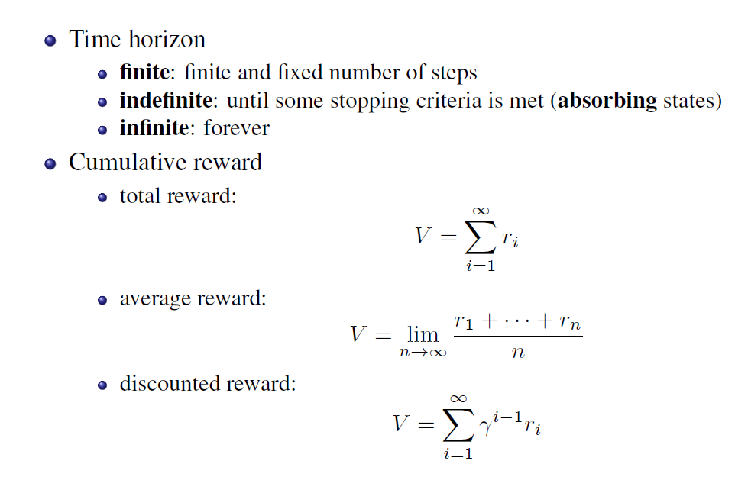
Rewards (or Returns)
© M.Restelli

Slide 5
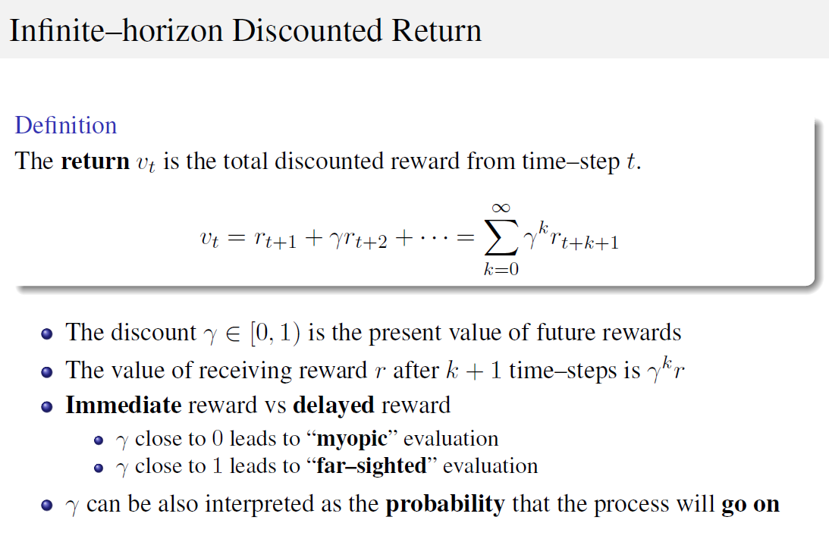

Slide 6
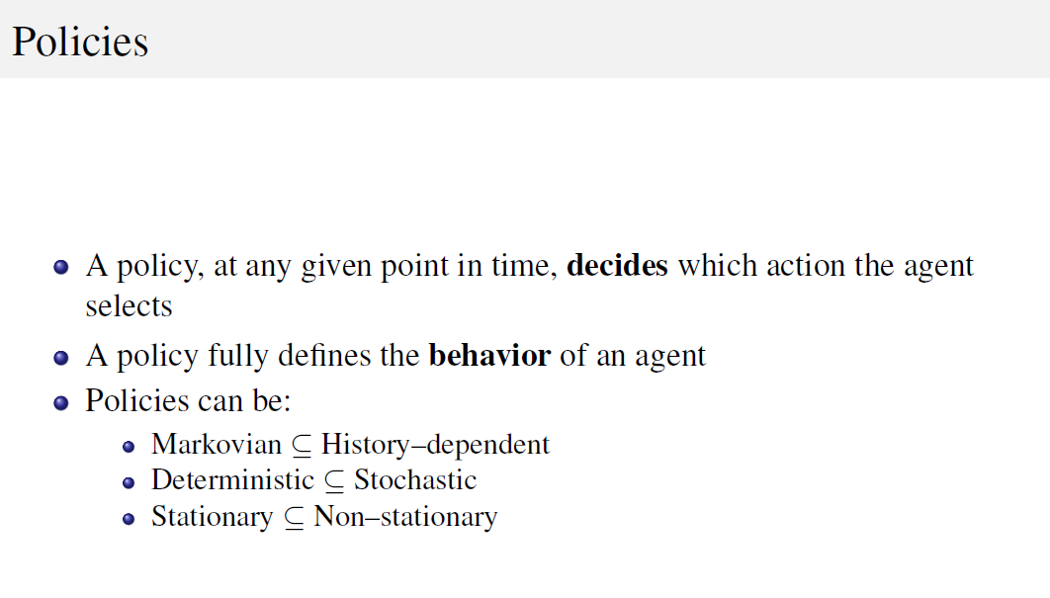
MDP=Markov decision process

Slide 7
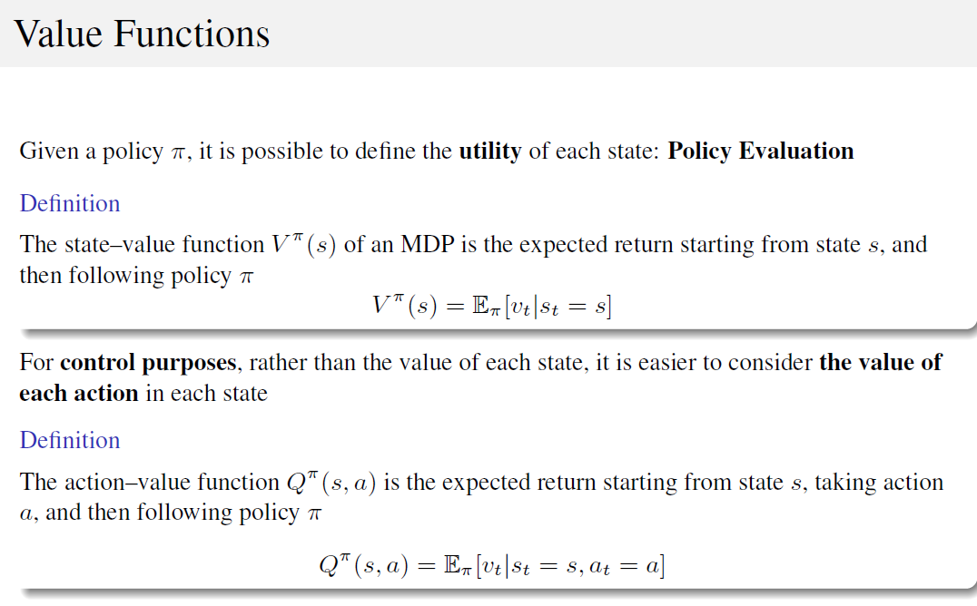

Slide 8
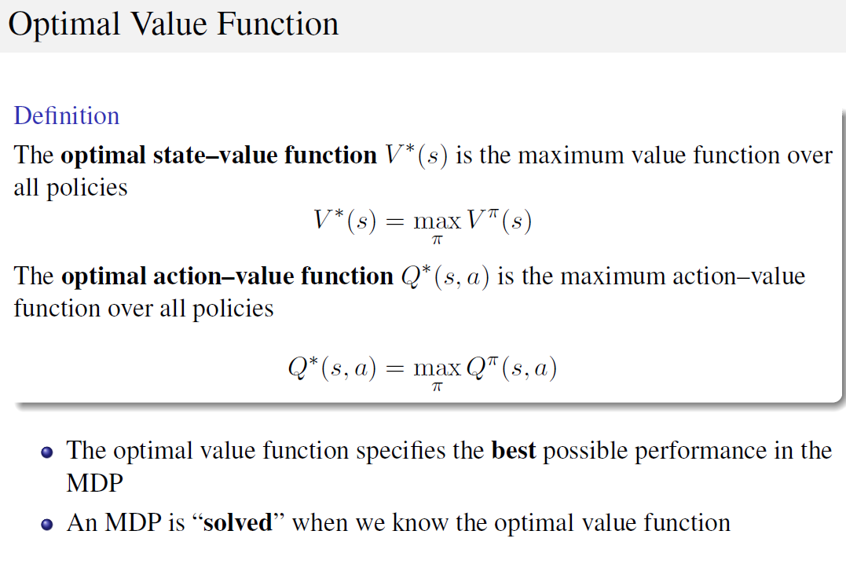

Slide 9
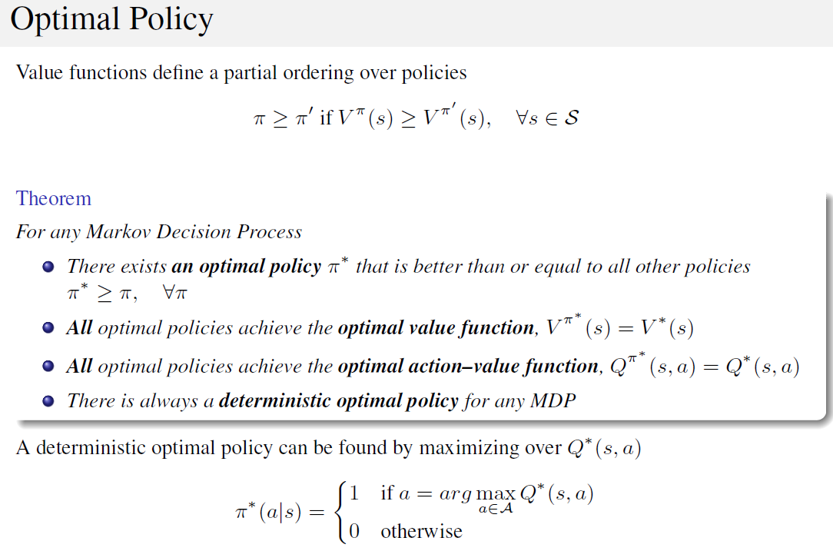

Slide 10
The More General Model: Actions and States
Initial State
Action Taken time 0
Reward time 1 State time 1
Action Taken time 1
S₀
A₀
R₁
S₁
A₁
A₃
R₃
S₃
A₂
R₂
S₂
Action Taken time 3
Reward time 3
State time 3
Action Taken time 2
Reward time 2
State time 2

Slide 11
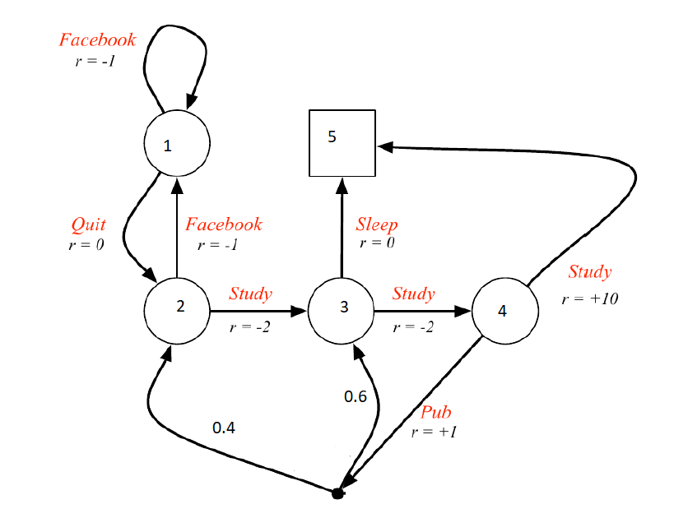
Example: preparing an exam
File: Preparing_Exam_MC.m

Slide 12
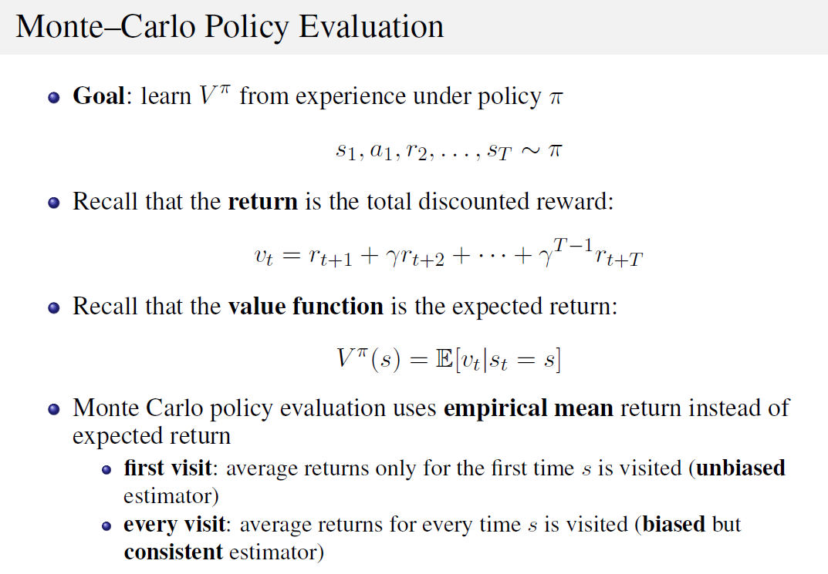

Slide 13
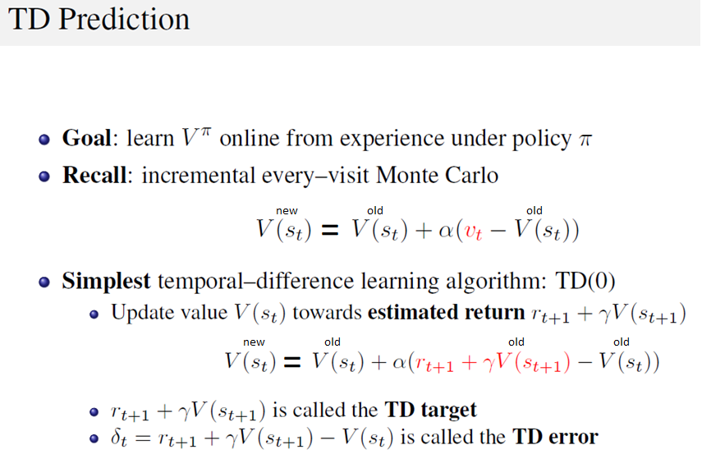

Slide 14


We can update either V or Q
MC: we usually set
or
$$Q(s,a)^{new}=Q(s,a)^{old}+\frac{1}{n}\left[v−Q(s,a)^{old}\right]$$
$$Q(s,a)^{new}=Q(s,a)^{old}+α\left[v−Q(s,a)^{old}\right]$$
for some parameter α (e.g. 0.1)
TD:
$$Q(s,a)^{new}=Q(s,a)^{old}+α\left[r+γVold−Q(s,a)^{old}\right]$$

Slide 15
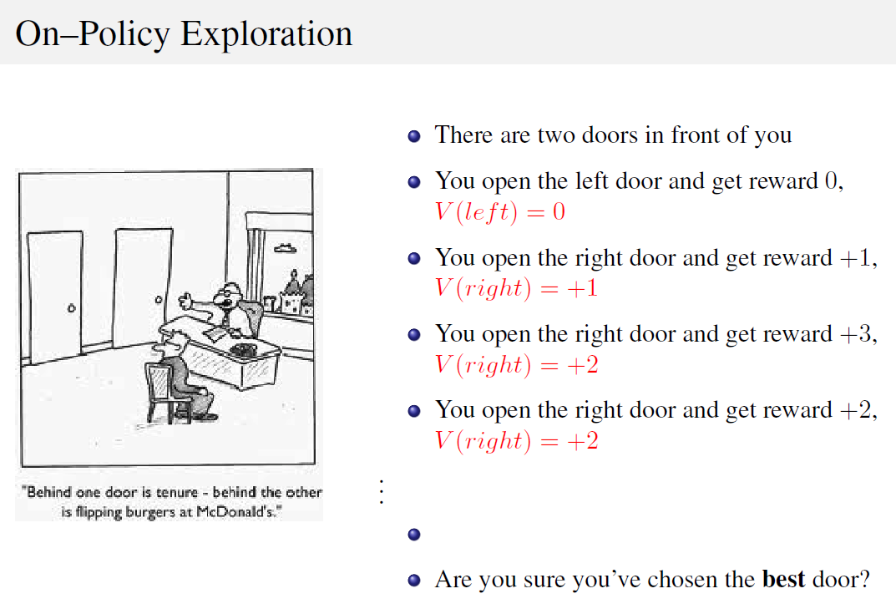

Slide 16
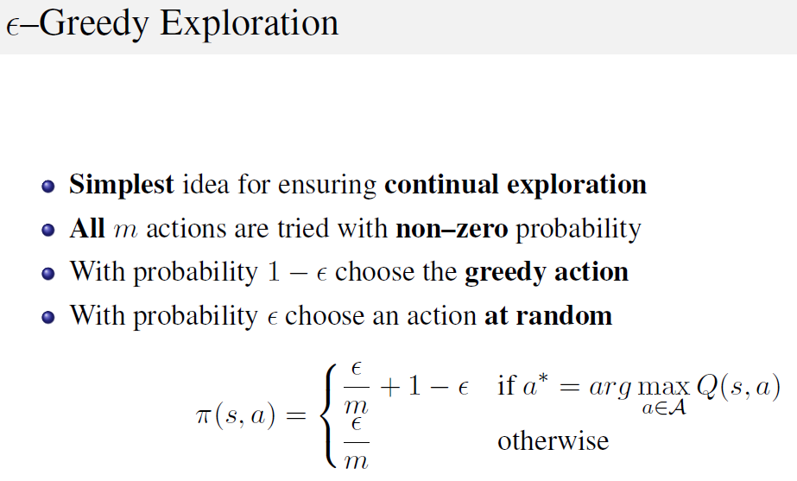

Slide 17
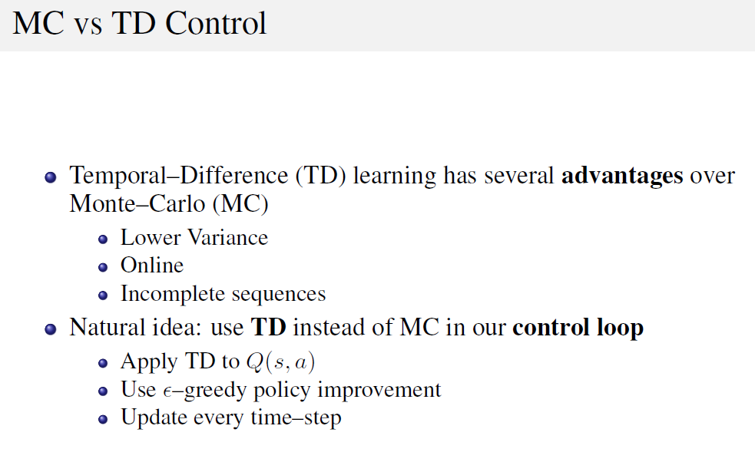

Slide 18
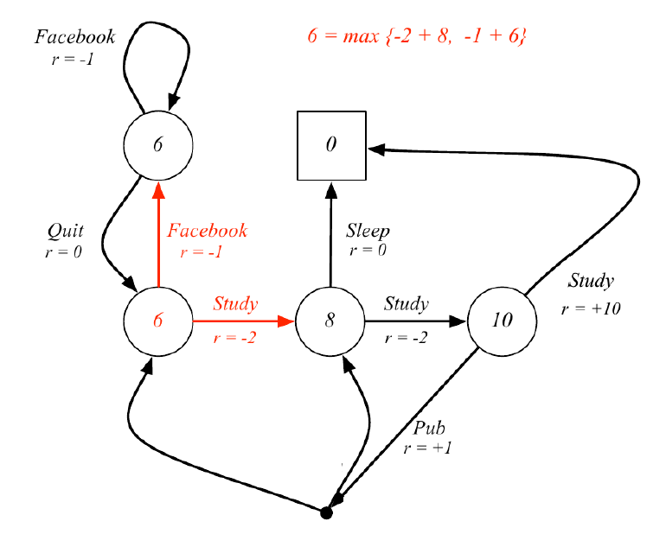
File: Preparing_Exam_MC.m
Preparing_Exam_TD.m

Slide 19
The exploration parameter ε and initial values
It makes sense to reduce ε over time. For example we can let it decline exponentially
The initial Q-values make a difference
If the standard deviation of the payoff is increased, a higher value of ε would be appropriate

Slide 20
n-step bootstrapping
Monte Carlo bases updates on what happens over the complete life of the trial
Temporal difference bases updates on what happens over the next period
n-step bootstrapping algorithms is between the two. It bases updates on what happens over the next n periods

Slide 21
When there are many states or actions (or both)…
The cells of the state/action table do not get filled in very quickly
It becomes necessary to estimate the Q(S,A) function from observed values.
As this function is in general non-linear a natural approach is to use artificial neural networks (ANNs) or RFs
We use an ANN or a RF to minimize the sum of squared errors between the estimates and the target
This is known as deep Q-learning or deep reinforcement learning

Slide 22
When the states are continuous…
We turn to function approximation methods to estimate the Q-values or policies.
These methods can handle continuous spaces by approximating the Q-values or policy using parameterized functions like neural networks.
Some popular approaches include:
Deep Q-Learning (DQN):
Extends Q-Learning by using a neural network or RF to approximate the Q-value function. This method is particularly useful when dealing with large (as in the previous slide) or continuous state spaces.

Slide 23
Policy Gradient Methods:
Instead of learning a value function, these methods directly parameterize the policy and optimize it using gradient ascent. Examples include REINFORCE, Actor-Critic, and Proximal Policy Optimization (PPO).
Actor-Critic Methods:
Combine the benefits of value-based and policy-based methods. The actor decides which action to take, and the critic evaluates how good the action was, using a value function. Examples include A2C (Advantage Actor-Critic) and DDPG (Deep Deterministic Policy Gradient).

Slide 24
Continuous Action Spaces:
Techniques like DDPG, Twin Delayed DDPG (TD3), and Soft Actor-Critic (SAC) are specifically designed to handle continuous action spaces effectively.
By leveraging these advanced reinforcement learning algorithms, we can tackle complex financial environments where decisions must be made in continuous spaces.

Slide 25
Proximal Policy Optimization (PPO)
PPO is a reinforcement learning algorithm introduced by OpenAI.
Balances simplicity, efficiency, and performance.
Enhances stability by limiting drastic updates to the policy.
PPO Workflow for Continuous State Spaces
Use a neural network to represent the policy and value function.

Slide 26

Key Concepts of PPO
1. Policy and Policy Gradient:
- Optimize a probabilistic policy π_{θ}(a∣s) to maximize cumulative rewards.
2. Clipped Objective:
- Prevents large changes in the policy via a ratio
3. Advantage Function:
- Quantifies how much better an action is than average
A=Q(s,a)-V(s)

Slide 27
PPO Objective Function
The objective function of PPO (to be maximized) is the expectation -which means that this function will be computed over different trajectories - of the minimum of two terms:
: this is the product of the ratio function and the advantage
⁡ : the policy ratio is first clipped to the range
[1−ϵ,1+ϵ]. Generally, ϵ is set to be 0.2. Then, as before, it is multiplied by the advantage.
clip(r,1−ϵ,1+ϵ): Limits r to the range [1−ϵ,1+ϵ]
e.g., clip(0.2,0.8,1,2)=0.8; clip(0.9,0.8,1.2)=0.9; clip(1.3,0.8,1.2)=1.2

Slide 28
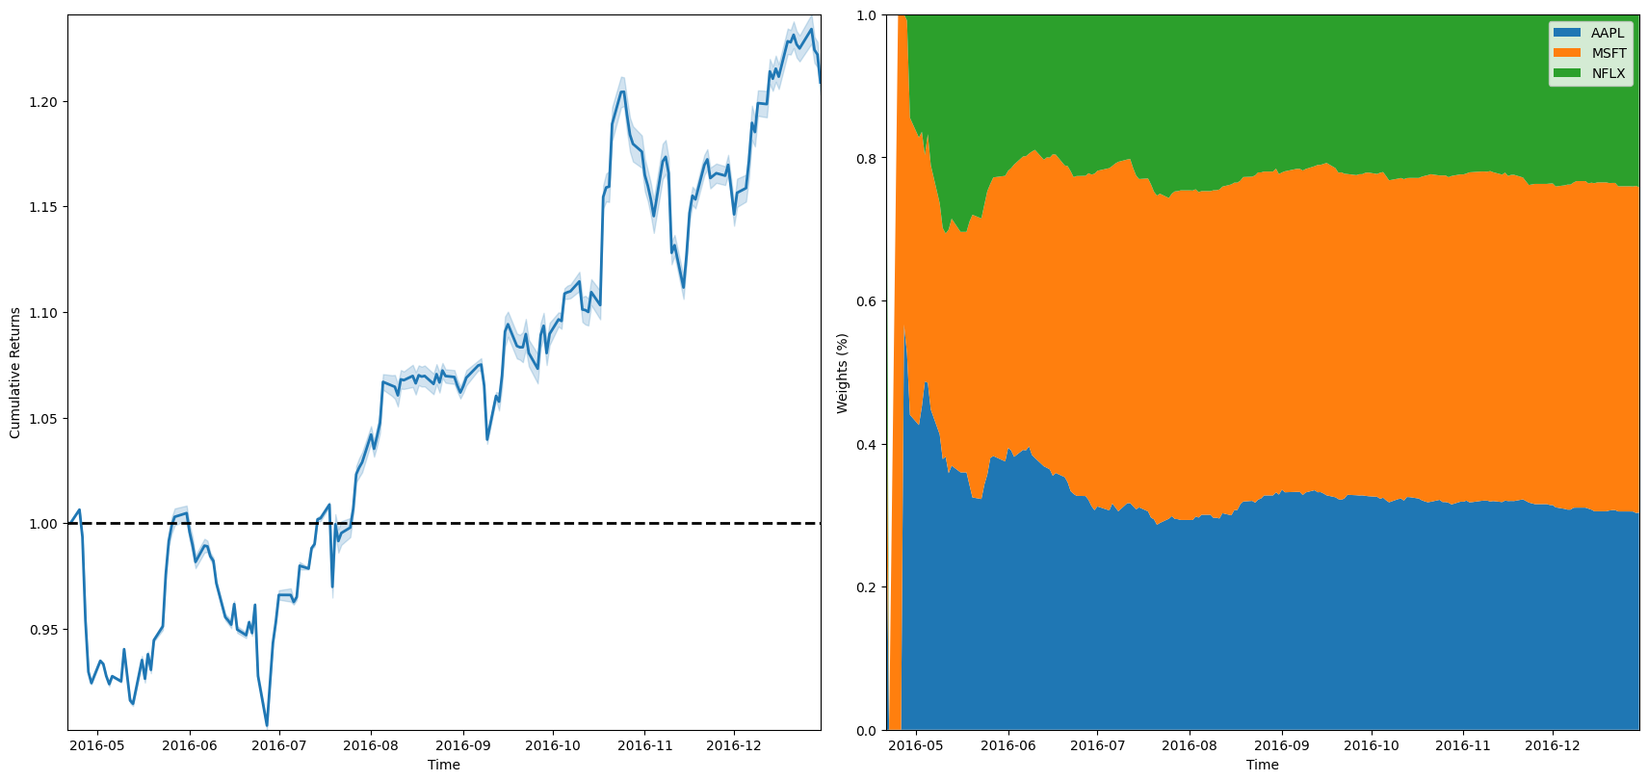
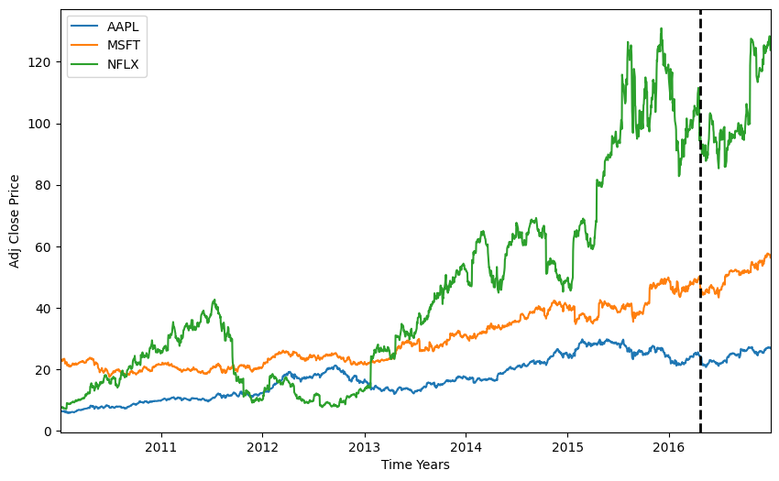
Let’s do a trading exercise
Algorithm: https://stable-baselines3.readthedocs.io/en/master/modules/ppo.html

